Slide 1
Archetypes and the EHR
Thomas Beale
Ocean Informatics
(Mooloolah, Australia)
EHR Colloquium,
Magdeburg, Dec 2002

Slide 2
The Patient In 2010 ....
My GP can see my vaccination history, my homeopathic prescriptions .... and my checkup for a possible thrombosis by a doctor in Berlin
My EHR is sitting on a community server in Provence (where I now live...), which has been running since 2007
I have consultations with my GP over live video, with my EHR visible to both of us
I add asthma monitoring data to my own EHR from home
When I move to Brazil next year (2011), all my EHR data will be understood in Portuguese by the Saõ Paulo doctors, and semantically by their systems...
I set my access policy, with my GP’s advice

Slide 3
The Doctor In 2010 ....
The GP sees my EHR as a collection of vital data, e.g. family history, current medications, therapeutic precautions, and a series of problem-based “lifelines”
She can query for any series of results in any time window, follow a problem thread, review my current situation and set recalls e.g. for backup vaccinations and follow-ups
My GP can audit my record to ensure all preventative and educational steps are being taken for me by other carers
The EHR is automatically synchronised with data gathered during my visits elsewhere in the health system
Intelligent decision support interacts automatically with my EHR, utilising guidelines and other knowledge resources to assist my doctor

Slide 4
The Health System In 2010 ....
Hospital and GP systems are all using one of a small range of quality, open source EHR back-end components – the secret databases of 10 years ago are gone
Every hospital CIO has a free choice of software, and refuses to talk to non-standards compliant vendors
Vendors compete on advanced functionality, service and support, not by locking in buyers. Vendors do not have to re-invent the EHR every time; small vendors survive
There is a global market for standards-compliant EHR applications, storage and communication solutions – much larger than the current market
Most chronic disease sufferers are entering data in their own EHR from home and have GP-guided online education, saving millions on routine visits

Slide 5
What’s Different In 2010 ....
30% of Health IT budgets are spent on developing health knowledge: drug dbs, guidelines, archetypes, terminology, ontologies...in synchrony with the EHR
There are integrated ontology, archetype and terminology building tools, and an online publishing network for the knowledge artifacts they produce
Software is developed based on small generic models; systems a built to consume knowledge definitions
Health knowledge structures are introduced to systems post-deployment
...and data is transmitted in ZML. YML was superseded in 2005. ZML is an efficient binary representation originally known as XXXXXX

Slide 6
What Happened Since 2002?
We started to understand the problem
We changed the way we do software
We made knowledge development a priority
We finally realised that international standards are important, and had to be implemented

Slide 7
Understanding the Problem

Slide 8
The Problem
Reality in 2002 | The Requirement
Life-time Healthcare | EHR valid for 120 years
Domain size and rate of change | Future-proof EHR systems
The technology bind(ing) | EHRs independent of platform, database, prog. Lang., vendor
Multi-contact health | Interoperability of information
Decision support, Epidemiology, population medicine | Queryable longitudinal data
Cost of health IT | Cheap systems and deployments, low integration costs

Slide 9
Public Enemy #1 –
Domain size & rate of change
Domain size: SNOMED = 1,000,000 elements
Change factors in the domain:
  First-time formal modelling of existing knowledge
  Operational workflow changes (mgt of acute head injury)
  New technology creates new information structures
  New research creates whole new concept spaces
=> Change is constant in health information
Costs in software, database & “stovepipe” maintenance, increase in time while quality reduces
We should describe the changing elements in knowledge bases, but we haven’t been...

Slide 10
Changing How We Do Software

Slide 11
Two Solution Principles
Recognising the rate and size of change in domain concepts...
We created a separation of:
  content and functionality of systems from
  deployment mechanisms (software, databases etc)
The ability for domain representatives to directly control the content and functionality of their systems

Slide 12
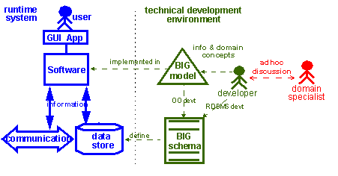

The Classic Way of
Developing Software
1998

Slide 13
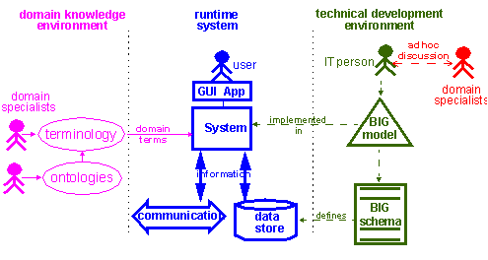
The Advent of the Knowledge Environment
2000

Slide 14
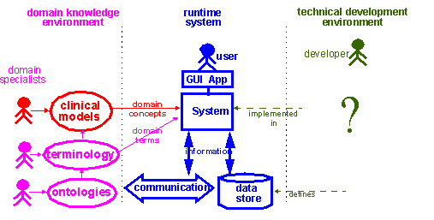
The Advent of Clinical Models
2002

Slide 15
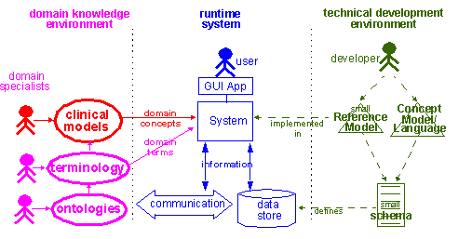
The Revolution
2003

Slide 16
Making Knowledge a Priority

Slide 17
The Knowledge / Information Separation
Information: statements about specific entities. For example, the statement “Gina Smith (2y) has an atrial septal defect, 1 cm x 3.5 cm” is a statement about Gina Smith, and does not apply to other people in general.
Knowledge: statements which apply to all entities of a class, e.g. the statement “the atrial septum divides the right and left atrial chambers of the human heart.
Mediation: any process which mediates between knowledge and information, such as inferencing, validation and induction

Slide 18
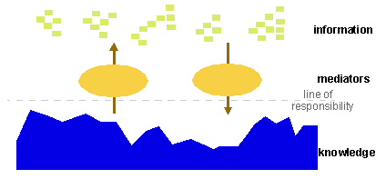
The General Scheme

Slide 19
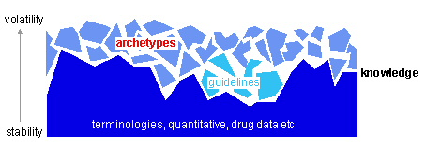
Towards Manageable Knowledge...

Slide 20
Towards Manageable Knowledge...
For change management and dissemination...
  Large knowledge bases = high-stability - terminologies
  Small knowledge bases = high-medium stability – small vocabularies, HL7 domains, guideline dbs, value sets
  Tiny knowledge bases = high-low-stability – archetypes
Authoring...
  Large terminologies – currently central
  Archetypes – distributed, even localised, as well as standardised

Slide 21
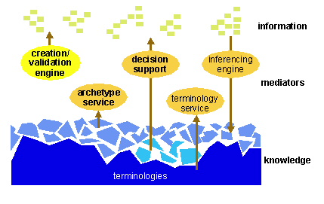
Where we are Going...

Slide 22
Relationship with Data, Systems
i-Focus = patient health data | Data | Models | Systems
Information (indiv. facts) | Clinical Data | EHR Reference Models | EHR system
Mediators |  | Kernel Model | EHR Kernel
Knowledge (fine, use-case-based, volatile) | Archetypes | Archetype formalism | Archetype editor
Knowledge (stable facts) | SNOMED, ICDx | e.g. OIL, DAML, SNOMED mdl | TQS, Galen environment

Slide 23
Archetypes

Slide 24
What is an Archetype?
A formal model of a clinical concept “in-use” (not a reference concept) – definition may be volatile...
Defines valid data configurations
Informed by terminology
Authored by domain specialists using tools
Saved as XML schema instance (or is it ZML?)
Used by systems to control creation and validation of data, and to perform querying
Used to share domain concepts

Slide 25
Technical Principles of Archetypes
0. Part of the Knowledge layer
Each Archetype is a Distinct Domain concept
Expressed as structure + constraints
Archetype Model based on Reference Model
Archetypes can be composed
Archetypes can be specialised
Archetypes can be versioned
Archetypes have paths
Data contains creating archetype id & paths
Basis for intelligent querying

Slide 26
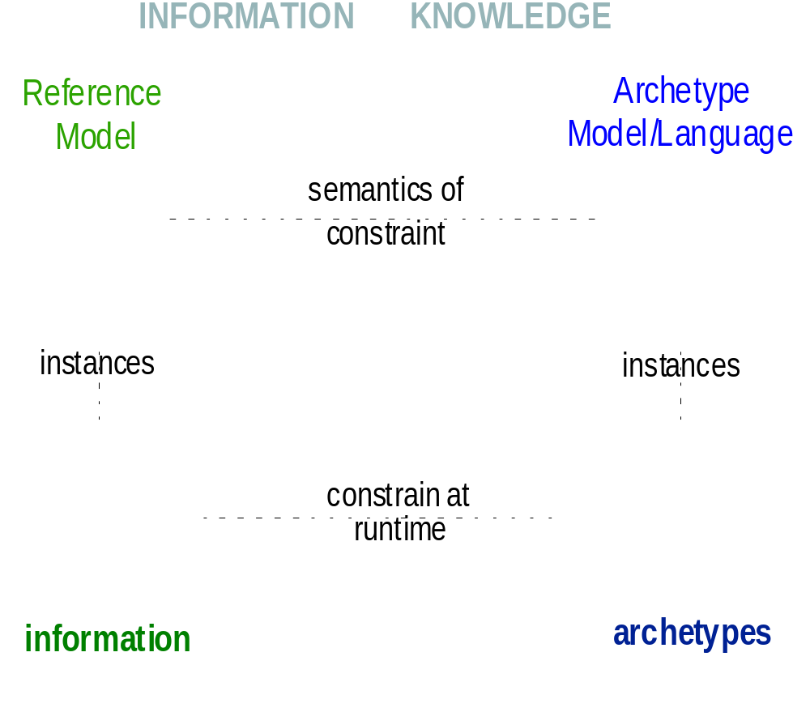
Archetype Model/Language

Slide 27
Archetypes at Design Time
Domain experts formally model the domain
Using GUI Tools ...
Collaboration between domain experts – workshops, design methodology
Quality Assurance – peer review (XML & clinical)
Dissemination – online repositories
Then available at runtime to systems...

Slide 28
Archetypes at Runtime
* Data input
MESSAGES
* Intelligent
querying
* conversion
Legacy
* validation
* Knowledge-
level
interoperability
* future-proof data

Slide 29
Planning for the Future (Technical)
Expect to spend less on software development, deployment and maintenance
Expect to spend time and $$ on developing and using knowledge models
Plan for “real” decision support, workflow, and other knowledge-enabled EHR-based processing
Plan to use standards at both the i-level and the k-level
Plan to turn legacy system schemas into archetypes

Slide 30
Planning for the Future (Social)
Clinicians need to learn to work together to define knowledge assets such as archetypes
Methodology for finding archetypes for content, workflow, security, business process needs to be developed
Patient education – as EHR users, content creators
Physician education – using new systems
e-Consent – patient consent interface to EHR platform

Slide 31
Activities 2002 +
CEN, openEHR archetype-enabled EHR reference models (RMs); template-enabled CDA
openEHR archetype model development – to work with CEN13606, openEHR, & CDA RMs
Archetype tool development
Methodologies for eliciting archetypes from actual data and workflow (au, nl, us, de,...)

Slide 32
Resources
openEHR – http://www.openEHR.org
Archetypes – http://www.deepthought.com.au/it/archetypes.html
DSTC GEHR-based demonstration archetype editor http://titanium.dstc.edu.au/gehr/clinical-model-builder/

Slide 33

Questions

